Slide 1
One size does not fit all -A market regime and sentiment-mitigated approach to algorithmic trading
Andres Caicedo, Anuva Agarwal, Cindy Chiu
Dev Patel, Nathan Luksik

Slide 2

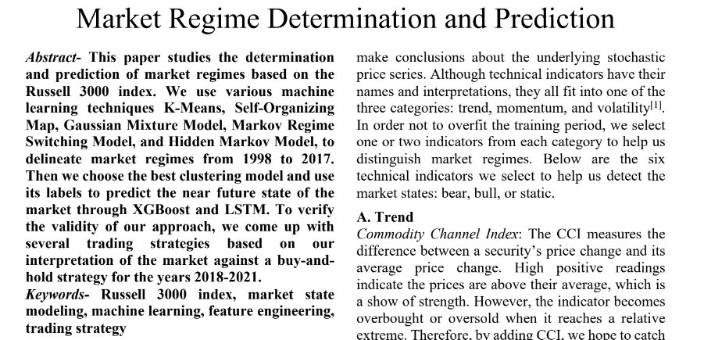

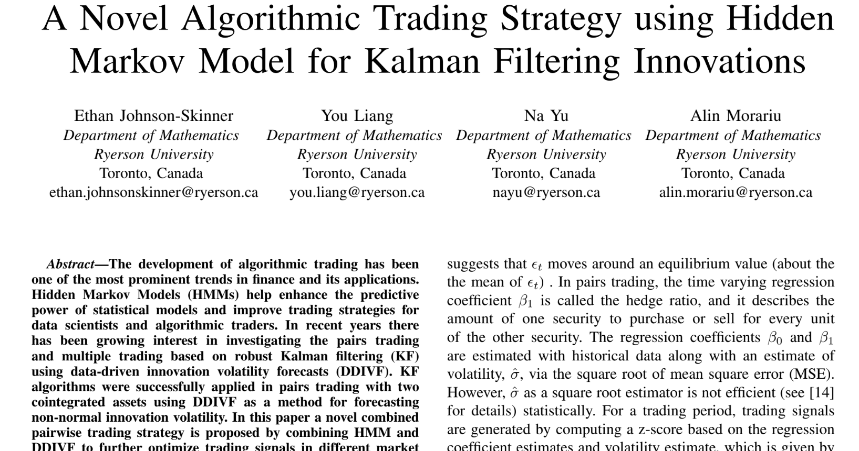
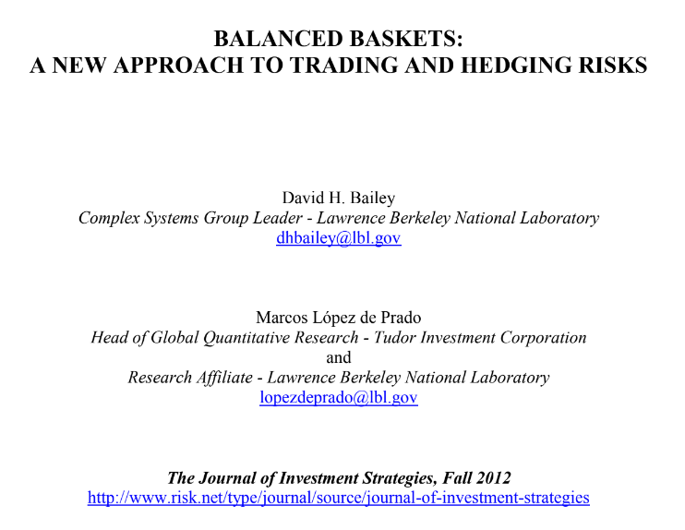
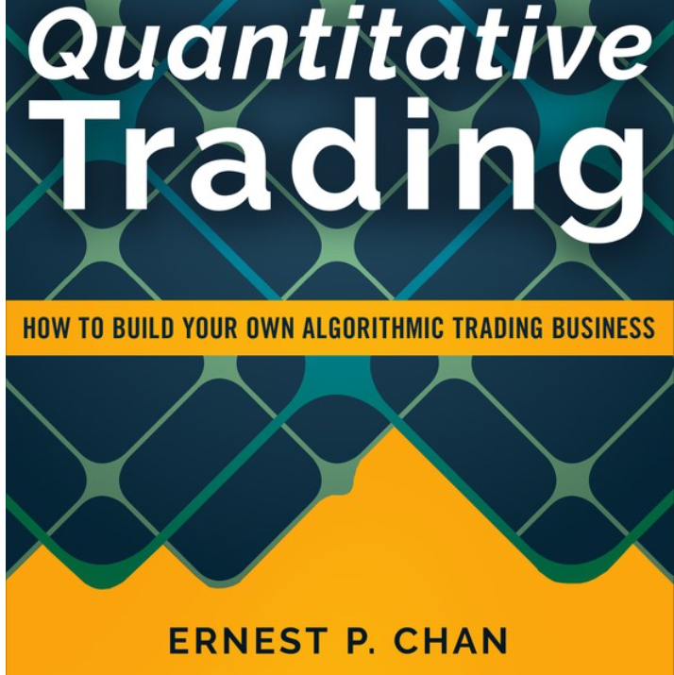

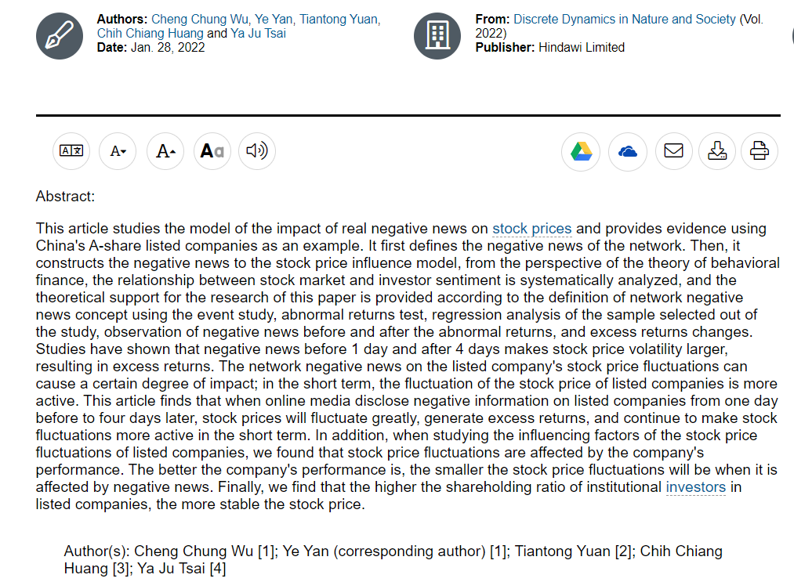


Foundation
Wang et al., 2020
Chan, 2013, 2021
Johnson-Skinner, 2021
Wu, 2021
Tibshirani, 2017
Two Sigma, 2021
Lopez de Prado, 2012, 2016, 2018, 2020

Slide 3
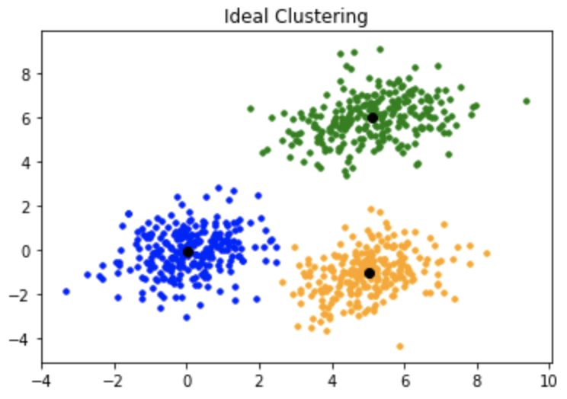

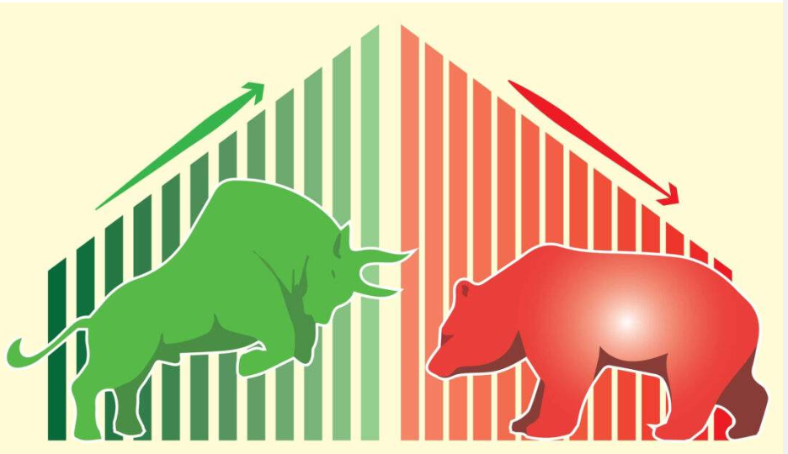


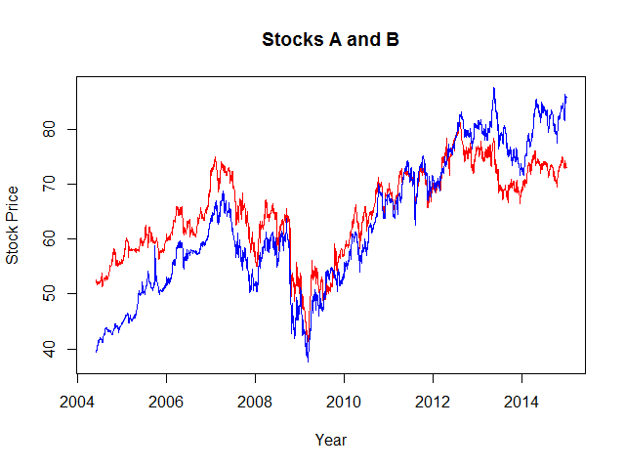

Our Strategy
Pairs Trading
Regime Switching
50% Capital
50% Capital
Market neutral
Should work well under any market
Reduce Risk

Slide 4
Pairs Trading
PCA & Clustering
Define Weights
Trade
Pairs
Select Pairs
Cluster within each sector, with market cap and returns
Run co-integration test and stationary test
Based on Contribution to Risk on z-scores
Set entry, exit and stop-loss threshold

Slide 5
Implementation
Monday
Friday
Daily
Daily
Refresh cluster and pairs
Trade pairs based on z-score
Reset pairs investment
Universe Selection, HMM determines regimes

Slide 6
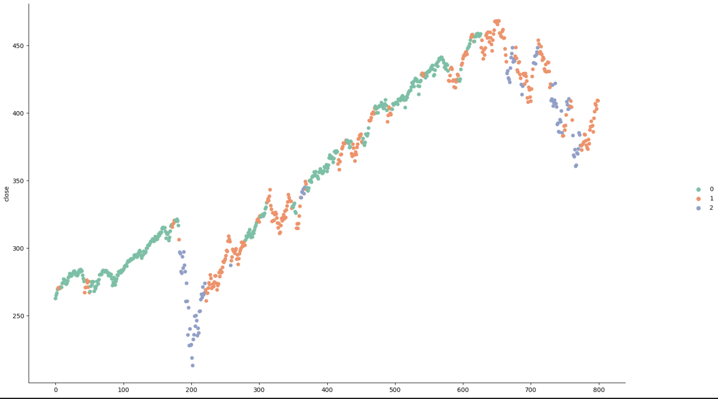
HMM for Regime Switching
Bull
Value
10-year SPY
HMM
Bear
Fama French
Notes:
Nathan

Slide 7
HMM Model Switch
Most Recent Data
10 day moving average
Daily Returns
Volatility
Best-fit
Distribution
HMM Training
K-S Test
Volatility PDF > 0.3
&
Return PDF > 0.5
No Pass
Pass
No Action
Model Switch
Notes:
Nathan

Slide 8
Bear Market Fama French
Asset pricing model based on fundamentals
Long and short portfolio
Favored small and value-oriented stocks
Factor model: macroeconomic and style
Factor 1
Factor 2
Factor 3
Price Change
Book Value per share
Book Value
Yield
Notes:
Nathan

Slide 9
Bull Market Value Model
Long only
High investor optimism – risk on
Least stock return over the past month
Market will eventually recognize value
Factor1
Factor2
Factor3
Factor4
3 month
total dividend per share
1 month price change
Book value per share
Free cash flow yield
Notes:
Nathan

Slide 10
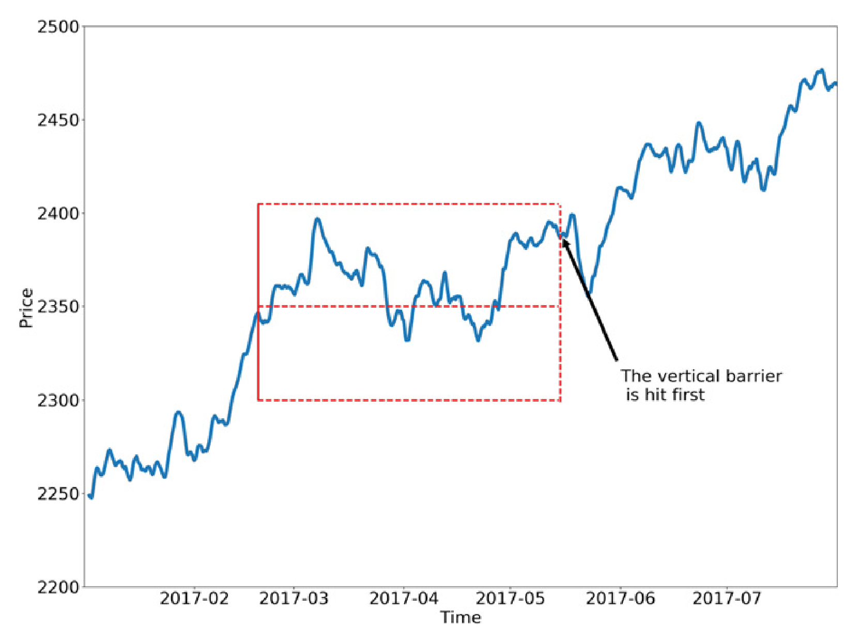
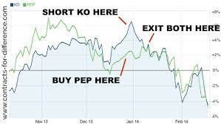
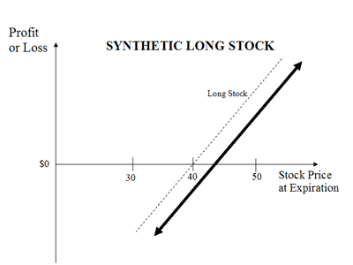
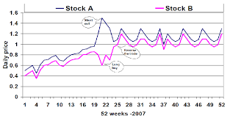
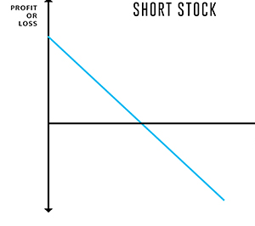
Risk Management
Triple Barrier
Equal Contribution to Risk
Long and Short Portfolio
Take profit, stop-loss, time barrier on pairs trading
Use the volatility of
z-score of each pair to determine weights
Fama French and pairs trading
Light Heavy

Slide 11
Incorporating Sentiment
Tiingo Data for 4 days
NLTK for sentiment scores
Only used in regime-switching strategy
Filter the universe and prevent stock entry

Slide 12
Backtesting Results
Time | In sample | OOS A | OOS B | Additional OOS | Stress Test
Profit | 17.28% | 31.99% | -14.47% | 11.47% | 1.64%
Sharpe Ratio | 1.248 | 1.476 | -0.654 | 1.529 | 0.937
Max Drawdown | 6.4% | 9% | 20.9% | 8.2% | 4.5%
Drawdown Period | 120 | 103 | 116 | 31 | 7
Max One-day Loss | 2.07% | 3.94% | 4.3% | 2.35 | 2%

Slide 13
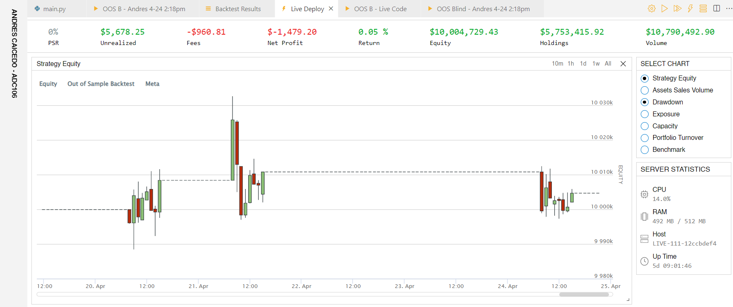
Live trading

Slide 14
Limitations
Resources
Subscription
Time constraint
QuantConnect has limited memory resources
QuantConnect limits the number of stock used
Optimizing between two strategies takes time

Slide 15
Future Work
Explore Leverage
Dynamic allocation between two strategies
Improve PCA
Improve Factor Models
Expand HMM

Slide 16
Thank you Any Questions?

